Slide 1
Sky gazer
BINARY BROTHERHOOD
Team member
ADITYA RAJ SINGH (24SCSE1011260)
ANKIT RAJ (24SCSE1010306)
KUMAR SHUBHAM (24SCSE1010890)

Slide 2
Introduction
SKY GAZER is a Java-based application designed to provide users with an interactive and informative platform for exploring celestial objects and astronomical events. With the increasing interest in space science and real-time sky observation, SKY GAZER aims to simplify and enhance the experience of sky-watching for students, hobbyists, and astronomy enthusiasts.
FOR USERS | FOR ADMIN
View real-time sky map | Add, update, or delete celestial object data
Search celestial objects by name or type | Manage astronomical event records
View upcoming astronomical events | Review and update educational content
Access educational content and sky-watching tips | Manage user accounts
Save favorite celestial objects or events | Perform database maintenance and backups
Simple, interactive GUI for easy navigation | Update application settings and configurations
Light/Dark mode for night viewing | Approve or verify new astronomical updates

Slide 3
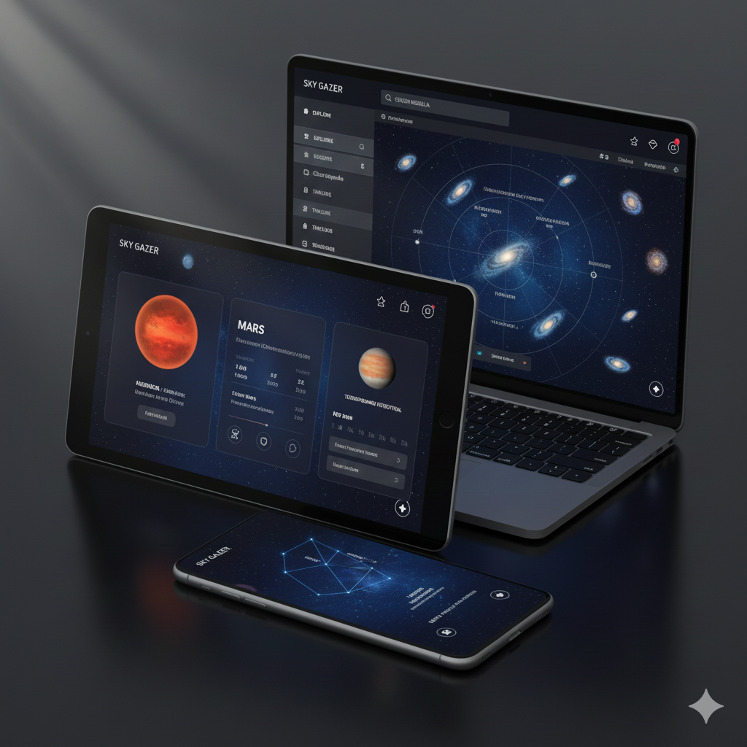
Sky gazer application

Slide 4
System Overview
The system allows students and visitors to:​
View sky objects​
Check upcoming events​
Search celestial objects​
Use interactive sky map​
Access learning content​
Save favorites​
Get event alerts​
​

Slide 5
Technologies Used
Technologies Used
Java (Core Java, OOP concepts)
Java Swing / JavaFX (GUI development)
MySQL / SQLite (Database storage)
JDBC (Database connectivity)
XML / JSON (Data handling, event data)
NetBeans / Eclipse / IntelliJ IDEA (IDE for development)
Java Collections Framework (Data management)

Slide 6
Conclusion
The SKY GAZER application successfully provides an interactive and user-friendly platform for students, visitors, and astronomy enthusiasts to explore celestial objects and upcoming astronomical events. Developed using Java and supported by a structured database, the system ensures accurate information, smooth navigation, and efficient data management.
By offering features for both users and administrators, the application enhances learning, simplifies sky observation, and promotes interest in astronomy. Overall, SKY GAZER demonstrates how Java-based technologies can be used to build an informative, reliable, and educational tool that makes sky exploration accessible to everyone.

Slide 7


